Slide 1
FNSA Pre-Convention Workshop 2023

Slide 2
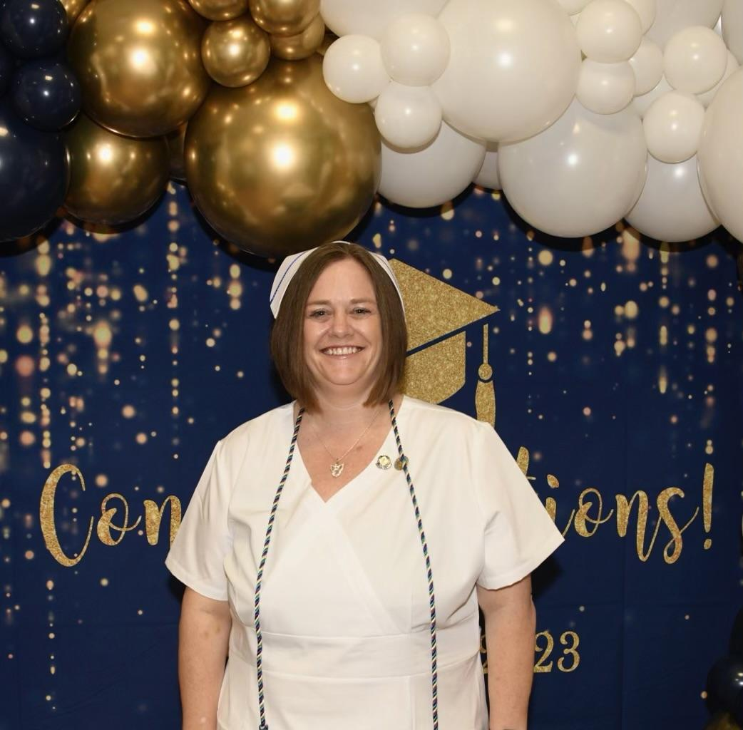
President
Kelly York BSN, RN
Keiser University
Graduated on April 26th , 2023!
Former Vice President of Keiser University’s SNA.
I am a NICU Nurse at St. Joseph’s Woman’s Hospital in Tampa.
Fun Fact: I have an identical twin sister!

Slide 3
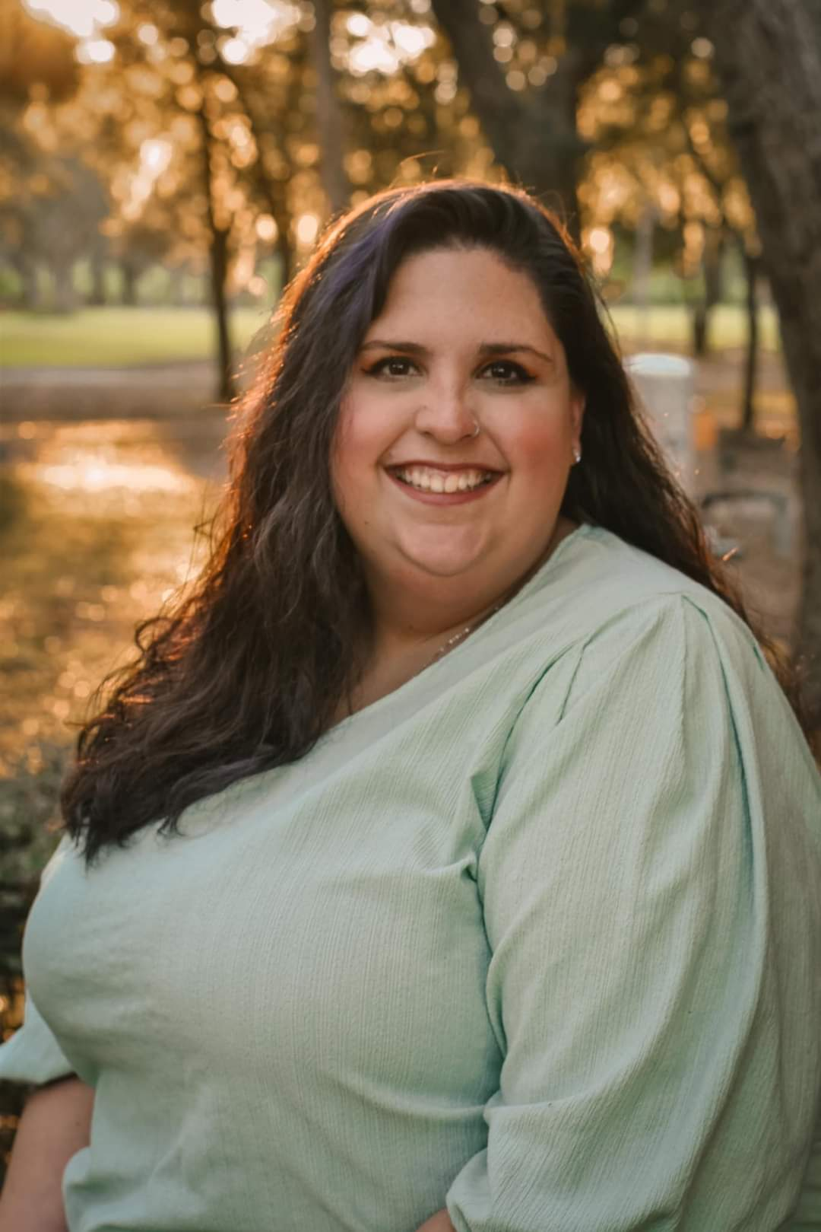
1st Vice President
Mikala Armioia
South Florida State College
Graduates in December 2023!
Currently SFSC’s SNA President.
I would love to work in an emergency department and eventually pediatrics.
A fun fact: I am literally always down for karaoke.

Slide 4
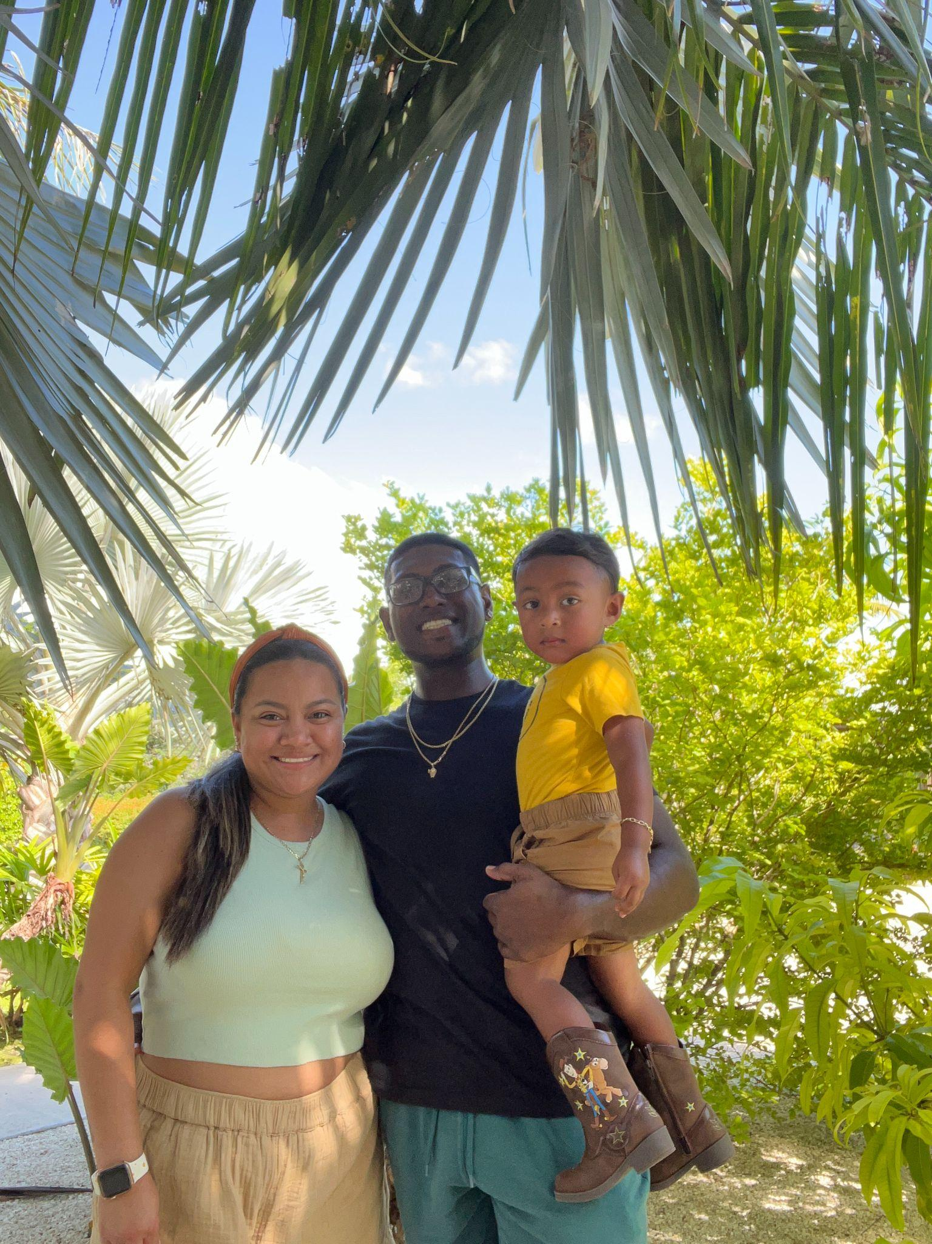
2nd Vice President
Clara Sooknanan
South Florida State College
Graduates in May 2024
Historian for SFSC’s SNA
Goal after graduation is to pass the NCLEX and start in the L&D department or neonatal unit
Fun fact: I’m really into making lego sets, currently made a Dobby (from Harry Potter)

Slide 5
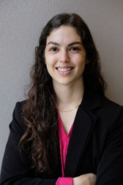
Recording Secretary
Jackie Eifert
AdventHealth University
Graduation Date: April 2024
Plan is to work in an emergency department after a nurse residency program, and work my way into flight nurse and travel nursing!
Fun Fact: I like to rock climb, make knives, watch movies, and hang out with family and friends.

Slide 6
Corresponding Secretary
This position is currently vacant!

Slide 7
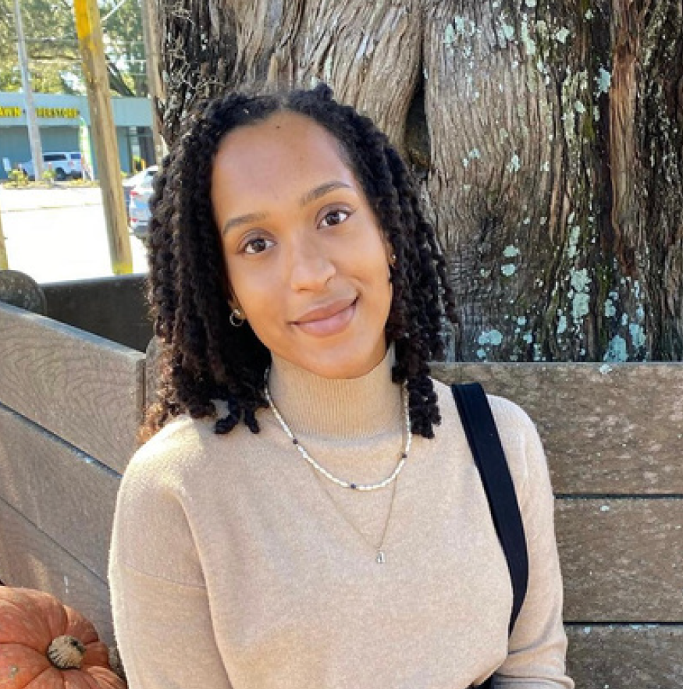
Treasurer
Alexis Frank, RN
Florida State College at Jacksonville
Graduated: May 2023
Future Plan: I start as a Perioperative Nurse in October 2023
Fun Fact: I love weightlifting and running and I have 22 houseplants. My favorite plant is the Black Velvet Alocasia.

Slide 8
Region 1 Director
This position is currently vacant!

Slide 9
Region 2 Director
Lakisha Carter
Florida State College at Jacksonville

Slide 10
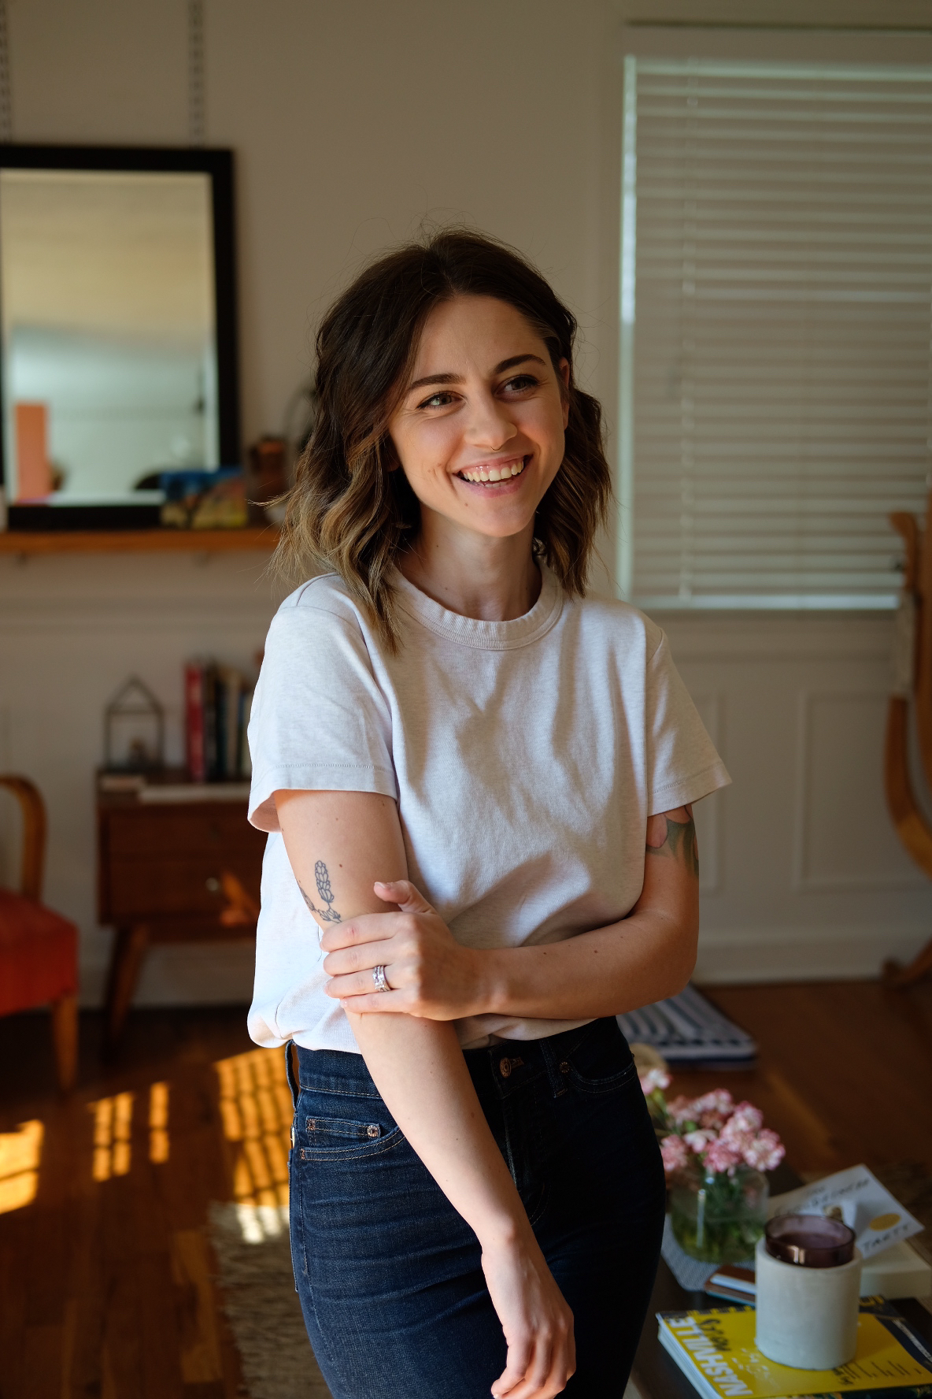
Region 3 Director
Amy Jones
AdventHealth University
Graduating April 2024!
Future Plan: I would love to work in critical care after graduation, focus on mastering my skills at the bedside and then transitioning into a clinical nurse educator/nurse leadership role in the future.
Fun Fact: I am super techy, I love to build and modify computers. it’s a hobby I can’t wait to get back into post grad! I’m also really into rock climbing.

Slide 11
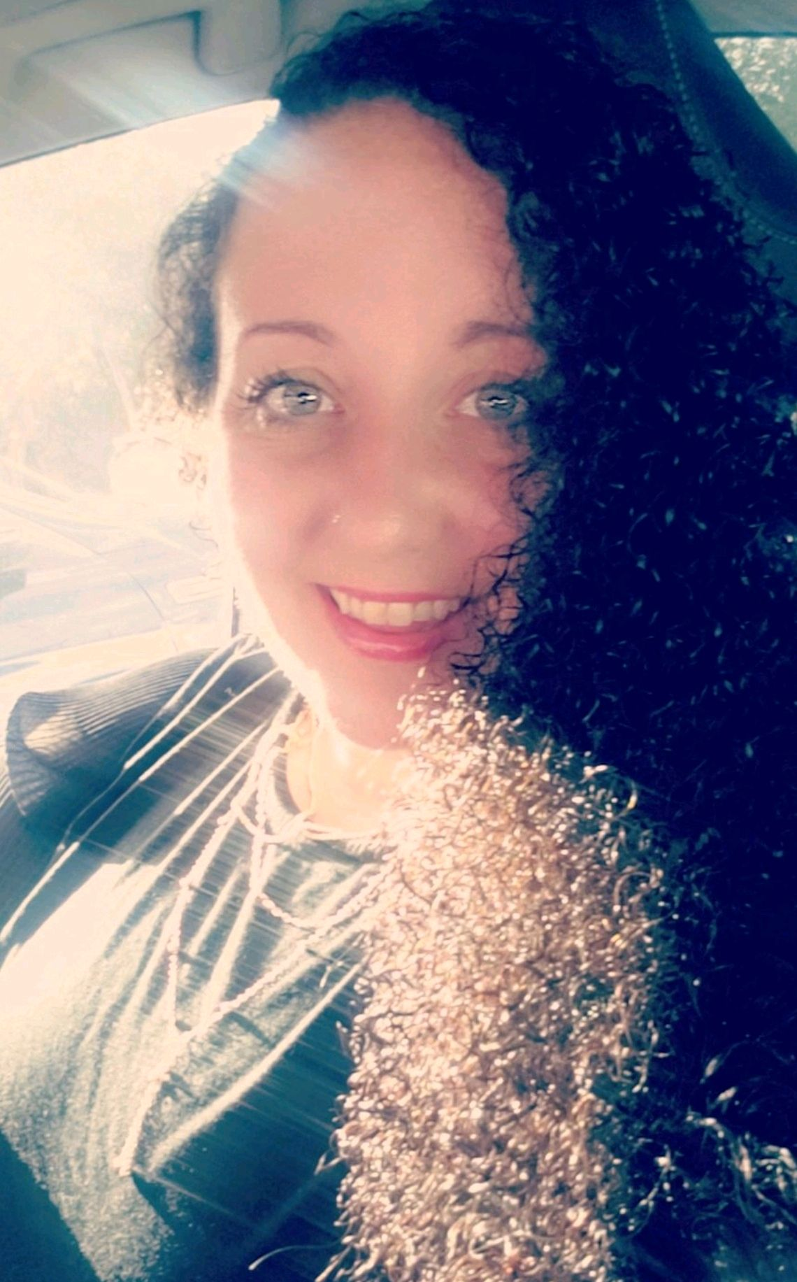
Region 4 Director
Carrie Faust
Keiser University - Melbourne
Graduated: August 26th, 2023
Future Plan: I begin my RN Journey with Health First on the 25th of September at Holmes Regional Hospital in the Emergency Room. My goal is to be a trauma nurse.
Fun Fact: I created a competitive dance team for a behavior center to improve confidence and team work in our youth.

Slide 12
Region 5 Director
Steve Greenwald
Indian River State College
Graduation - anticipated December 2023
IRSC’s SNA President
My future plan is to work in Oncology while I continue my education to obtain my MSN Family Nurse Practitioner with a focus on Mental Health of oncology patients
Fun Fact: I have been to 49 states and lived in 6!

Slide 13
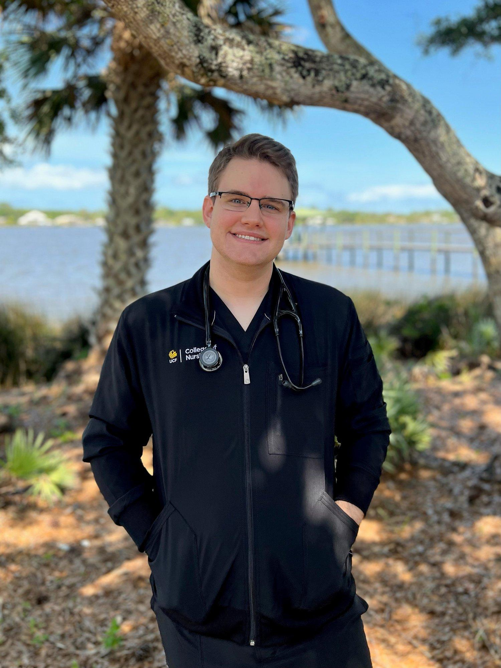
Region 6 Director
Pearce Copeland
University of Central Florida

Slide 14
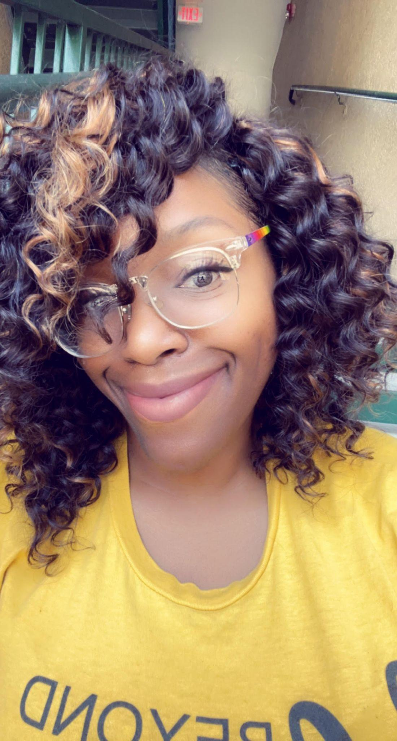
Region 7 Director
DeeDee Lane
Herzing University
Graduates: October 6th, 2023
Currently Herzing University’s chapter President.
Future Plan: Upon graduation, I'm excited to say that I intend to continue my education and pursue a Bachelor of Science in Nursing (BSN). Ultimately, I see the BSN as a stepping stone for career growth, specialized roles, and potential further education in the field of nursing.
Fun Fact: I have rappelled from a helicopter!

Slide 15
FNSA State Convention 2023
Exploring the Depths of Nursing
October 22-25, 2023
Embassy Suites Lake Buena Vista
Kissimmee, FL

Slide 16
Book Your Hotel Room Today!
https://book.passkey.com/e/50646744
Deadline is Oct 1, 2023
*The special room rate of $169/night ends that day*

Slide 17
Convention Highlights
Pre-registration ends 10/18/2023!
If your chapter would like to have a table to sell merchandise please let me know at fnsa2ndvp2023@gmail.com.
*Costs $25 per table and must be provided to Clara or Willa Fuller by 12:45pm October 23th. **first come, first serve**

Slide 18
Convention Highlights
The tentative convention schedule is on the fnsa.net website. Some of the focus sessions we will be having are:
Panel Discussions Exploring the Depths of Nursing
Pharmacology Made Insanely Easy
EKG and Clinical Disasters
Rocking the Interview, Resume, & Portfolio!
Preventing Burnout
AMAZING EXHIBIT HALL!!!!

Slide 19
Speakers
Featuring:
Hospice Nurse
Attorney/ER Nurse
Flight/Forensic Nurse
ICU Nurse

Slide 20
Bring out your feathers and pearls, we are going back to the roaring 20s!

Slide 21
Privilege of being a Delegate
Delegates are an integral part of the organization and convention running smoothly. The delegates are responsible for:
Voting on bylaw amendments to the FNSA Bylaws
Voting on resolutions written by constituents of FNSA
Voting for members of the Executive Board to serve the following year
Nominating candidates for Executive Board positions during convention that have not been preslated

Slide 23
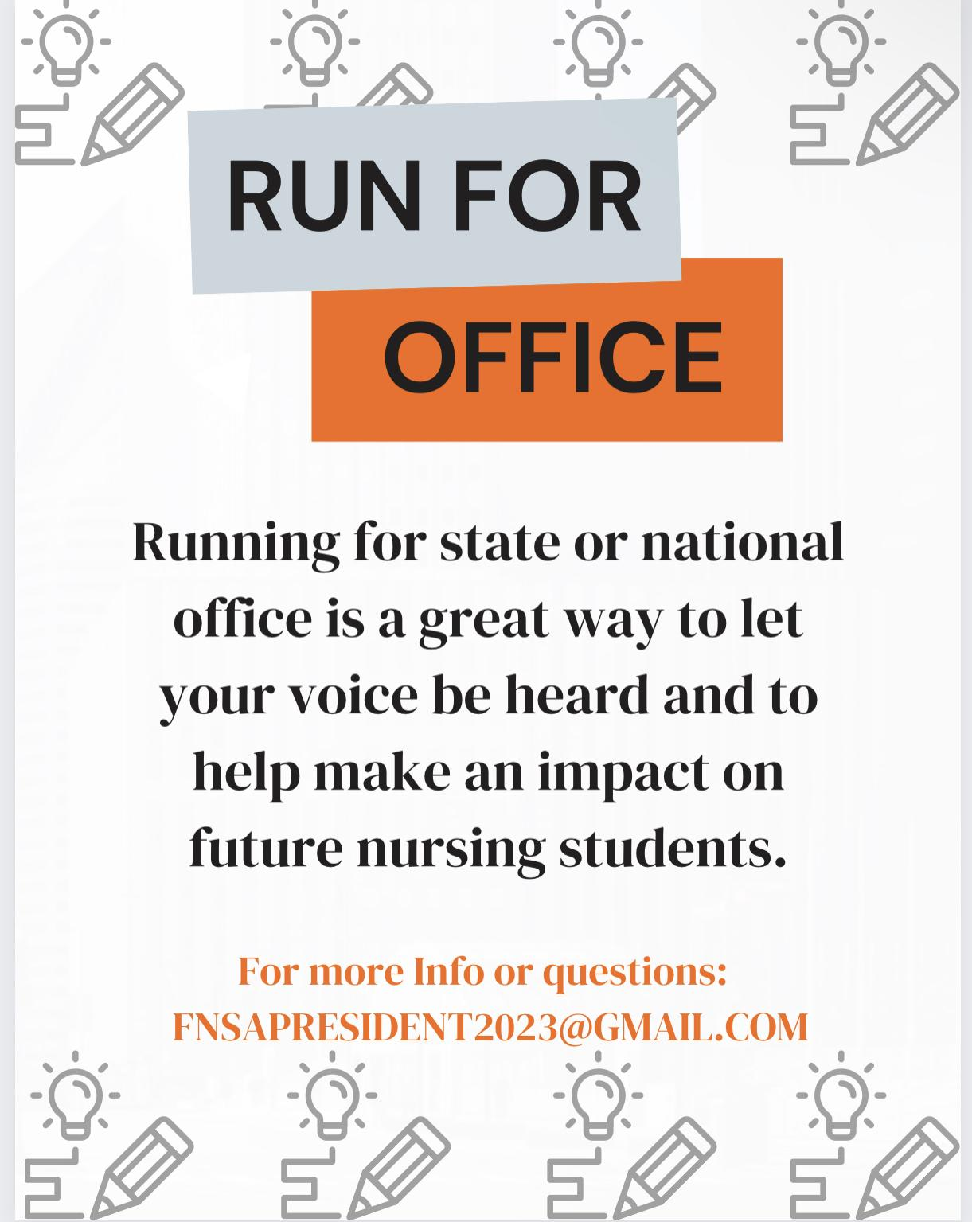

Slide 24
What it means to serve…
Being a member of the FNSA Executive Board
As a potential candidate and member of the Executive Board, you will be representing the interests of nursing students throughout Florida. When running for a position on the FNSA Executive Board, you must understand the duties and responsibilities of the office for which you intend to run.
Notes:
Kelly

Slide 25
President
Preside at all meetings of FNSA and Executive Board
Appoint special committees with the approval of the Executive Board
Appoint Regional Directors to positions of committee Chairpersons at the post-convention Executive Board meeting.
Serve as an ex-officio member of all committees except the Committee on Nominations and Elections.
Act as the Chairperson of the Regional Directors.
Appoint Special Liaisons to the FNSA Executive Board with the approval of the Executive Board.
Plan and implement the Pre-Convention program.

Slide 26
First Vice President
Chairperson of the Bylaws and the Peer Review Committee
Make revisions to the state bylaws, as necessary, after the annual meeting.
Submit a set of revised bylaws and a constituency application to each FNSA district.
Assist the President.
Notes:
1. Have been a member of FNSA for at least one (1) year. 2. Have held office previously on the local, state, or national level 3. Have attended at least one (1) State or National Convention previous to the one (1) in which the nominee seeks to appear on the ballot
(g) In the event there are no qualified candidates who meet the above criteria, any member may be considered at the discretion of the NEC and Executive Board.
‹#›

Slide 27
Second Vice President
Roles and Responsibilities of the Second Vice President
Being a chairperson of the committee on conventions and programs and helping out with any other duties needed.
Being in this position includes helping to plan this year’s annual convention and coordinating guest speakers in leadership roles to help inspire nursing students! I help plan the location, agenda, and programs

Slide 28
The Role of Treasurer
Promote ways to raise scholarship funds for the Florida Nursing Students Association. Ex: bake sales
Promote through :
Ways and means Committee ( You don’t do this alone)
Social media
Informing SNA presidents at different schools via emails and flyers.
Pennies PRN
The overall PURPOSE is to raise scholarship funds for nursing students to help students pursue their career in nursing without experiencing financial burdens and stress.
Notes:
The overall role of the Treasurer is to raise scholarship funds in order to help nursing students in their education. I raise the funds through leading the ways and means committee (which I will talk in further depth in the powerpoint), social media, pennies PRN, and through the Chapter SNA presidents.

Slide 29
Corresponding Secretary
Responsibilities
The voice between the FNSA board and its members.
Type and send a newsletter, Hotline, after every board meeting
Chairperson of Image of Nursing Committee and Awards Coordinator.
Keep all official correspondence for FNSA.
Work to promote a positive images of nurses and the profession

Slide 30
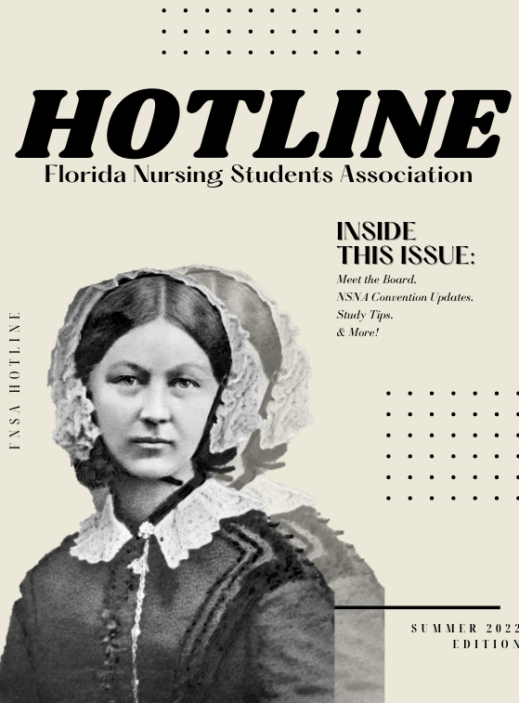
Corresponding Secretary
FNSA Hotline
A copy of the Hotline is sent to your school by your regional directors
The Hotline is also found on the FNSA website under the Hotline tab

Slide 31
Recording Secretary Responsibility
Keep Minutes
Most important part
Archives
Organize records
Responsibilities
To National
To board
To State

Slide 32
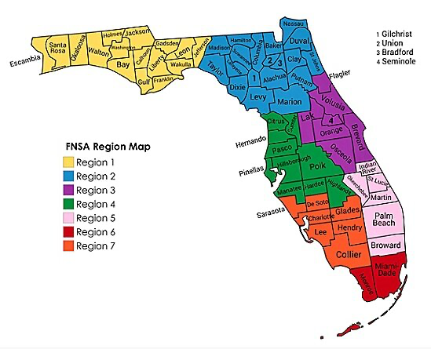
Region Directors
Notes:
We have 7 regions
and each of those regions is assigned to a Director which serves as the liaison between the nursing schools in those regions and the Florida Nursing Students Association.
In this map you can see more or less how these regions are divided. Later on I will show a few slides of the schools that correspond to each region so that you have an idea and know better which Director corresponds to you, if you ever need to contact them.

Slide 33
Responsibilities as a Region Director
Represent schools in designated region
Attend Executive Meetings
Maintain communication between chapters and Executive Board
Regional activities
Exchange ideas, activities, functions
Chair a Committee

Slide 34
What Region Are You?
REGION 1
Florida A&M University
Florida State University
Gulf Coast State College
Northwest Florida State College
Pensacola Christian College
Pensacola State College
University of West Florida
REGION 2
College of Central Florida
Florida Gateway College
Florida State College
Jacksonville University
Keiser University- Jacksonville
North Florida Community College
Rasmussen College- Ocala
Santa Fe College
St. Johns River State College
University of Florida
University of North Florida
REGION 3
AdventHealth University
Bethune Cookman University
Daytona State College
East Coast Polytechnic Institute
Eastern Florida State College
Keiser University- Melbourne
Lake Sumter State College
Seminole Community College
University of Central Florida- Cocoa, Daytona, Orlando
Valencia College

Slide 35
What Region Are You?
REGION 4
Florida Southern College
Hillsborough Community College
Keiser University- Lakeland, Sarasota, Tampa
Pasco-Hernando Community College
Polk State College
Rasmussen College- New Port Richey, Tampa/Brandon
Saint Petersburg College
South Florida State College
South University- Tampa
Southeastern University
University of South Florida
University of Tampa
Utica College
REGION 5
Broward College
Florida Atlantic University
Indian River State College
Keiser University- Ft. Lauderdale, Port St. Lucie
Nova Southeastern University
Palm Beach Atlantic University
Palm Beach State College
South University- West Palm Beach

Slide 36
What Region Are You?
REGION 6
Barry University
Florida International University
Florida Keys Community College
Miami Dade College
University of Miami
West Coast University
REGION 7
Florida Gulf Coast University
Florida Southwestern State College
Rasmussen College- Ft. Myers
State College of Florida
Notes:
You can find your specific Region Director’s contact information in the FNSA website.

Slide 37
Who Can Run?
Any member of FNSA who has been nominated shall be eligible to be a candidate for office, subject to the requirements of the following:
Candidates shall be in good standing with FNSA.
Candidates must present a completed application for nomination to the Committee on Nominations and Elections by October 6th, 2023.
Candidates must have written recommendation from their Dean or Director of Nursing or other appropriate faculty, that they are in good academic standing and that they have their support to run for office.
For the offices of President, 1st Vice-President, and 2nd Vice-President the candidate must meet a ​minimum of one or more​ of the following:
Have been a member of FNSA for at least one (1) year.
Have held office previously on the local, state, or national level.
Have attended at least one (1) State or National Convention previous to the one (1) in which the nominee seeks to appear on the ballot.
Notes:
kelly

Slide 38
When to apply:
The 2023 pre-slating window opens September 17th and closes at 11:59 PM on October 6th. Applications submitted after this date will not be considered for pre-slating; although you will have another opportunity to run for office during the House of Delegates at State Convention, which will be held this year at Embassy Suites Lake Buena Vista from October 22-24th.
https://form.jotform.com/232575090380051
Email your applications to Kelly at fnsapresident2023@gmail.com and Willa Fuller at Wfuller@floridanurse.org
Notes:
Encourage preslating- can plan their campaign
Take the first step in pursuing your interest and involvement in serving as an Executive Board Member of the FNSA!
Check out the NEC Handbook on the FNSA website for details about the application process and eligibility requirements.
Whether you want to serve as an Officer on the Executive Board, or work alongside your FNSA Representatives and serve on a Committee, there are many opportunities to explore.
The growth and success of the FNSA and Student Chapters throughout the State of Florida depend on the Board and student members, and it all starts with Nominations & Elections.

Slide 39
Break
We will resume the meeting at 10:15am

Slide 40
Resolutions
What is a resolution?
Written document declaring FNSA’s stance on a variety of nursing/healthcare-related issues that determines this organizations policies and actions.
Composed of 2 parts: Whereas vs. Resolved
"Whereas" clauses that summarize, with documentation, the reasons and rationale for the resolutions; and
"Resolved" clauses that contain the position to be taken on the issue and/or actions to be taken by FNSA, its constituent associations, and its members.
Notes:
What is a resolution?
A resolution is a written document proposing change or action. At the student level this is a way to be an active participant in the growth of our profession and the streamlining of policy and procedure.
Resolutions are comprised of many parts but at its core, its mini research that aims to propose a solution to a problem or concern in our field.
We’ll talk more about whereas and resolved statements in the future but here is a short video referencing how resolutions are presented for approval during our house of delegates meeting.

Slide 41
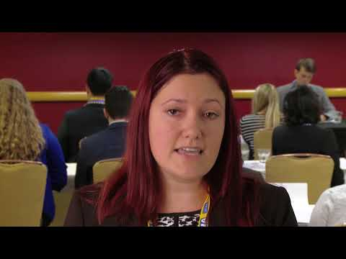

Slide 42
Resolutions
How to get a resolution passed at Convention
Resolution Authors Meeting
Resolution Hearing
2 minute speech from author
Pro/Cons
House of Delegate Voting
Notes:
So, how do you get started?
propose a topic of interest to a group of students at your school, seek faculty support if needed and host a resolution authors meeting.
Conduct research on your topic
write your resolution using a template we provide for you!
and then present it at your annual convention.
Be ready to DEBATE! Pro and con statements will be presented from the floor.
Once the session is concluded voting will take place to either approve or deny your resolution.

Slide 43
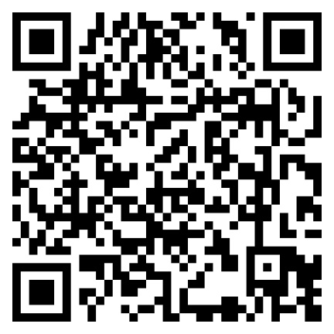
Resolutions
How do I submit a Resolution?
Use the link below to submit all necessary documents for your resolution:
Resolution
Reference List
Reference Documents
Abstract
Estimated Cost
Contact list
https://form.jotform.com/232579005264153
Due date is October 6, 2023 by 11:59 pm
Notes:
This is a list of things your resolution submission needs to include:
the resolution itself
a reference list
reference documents
an abstract explaining your proposal
Estimated cost (if any)
contact list of authors
Submissions for this years convention is October 6th! So please submit as soon as possible we can't wait to hear your ideas!

Slide 44
Constituency Application and Bylaws
Constituency Applications
Found under the Convention tab on the FNSA website.
Submitted at the Annual House of Delegates Meeting at convention
Can be submitted up to 10 working days after the close of House of Delegates
Schools must have a minimum of 10 members or the schools total enrollment if less than 10 to be recognized as a constituent of FNSA.
Constituents are eligible to send Delegates to the annual House of Delegates meeting during convention
Delegates
Each constituent school is awarded 1 delegate per 15 members
Alternates
1 alternate delegate for schools with 1-5 delegates
1 additional alternate delegate for schools with 6-10 delegates
Delegates must be credentialed to vote in the House of Delegates session.
https://form.jotform.com/232575846032054

Slide 45
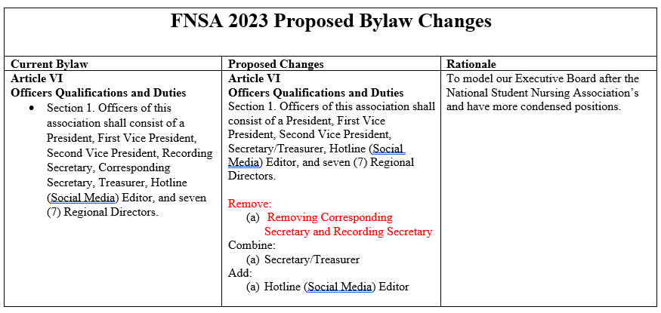

Slide 46
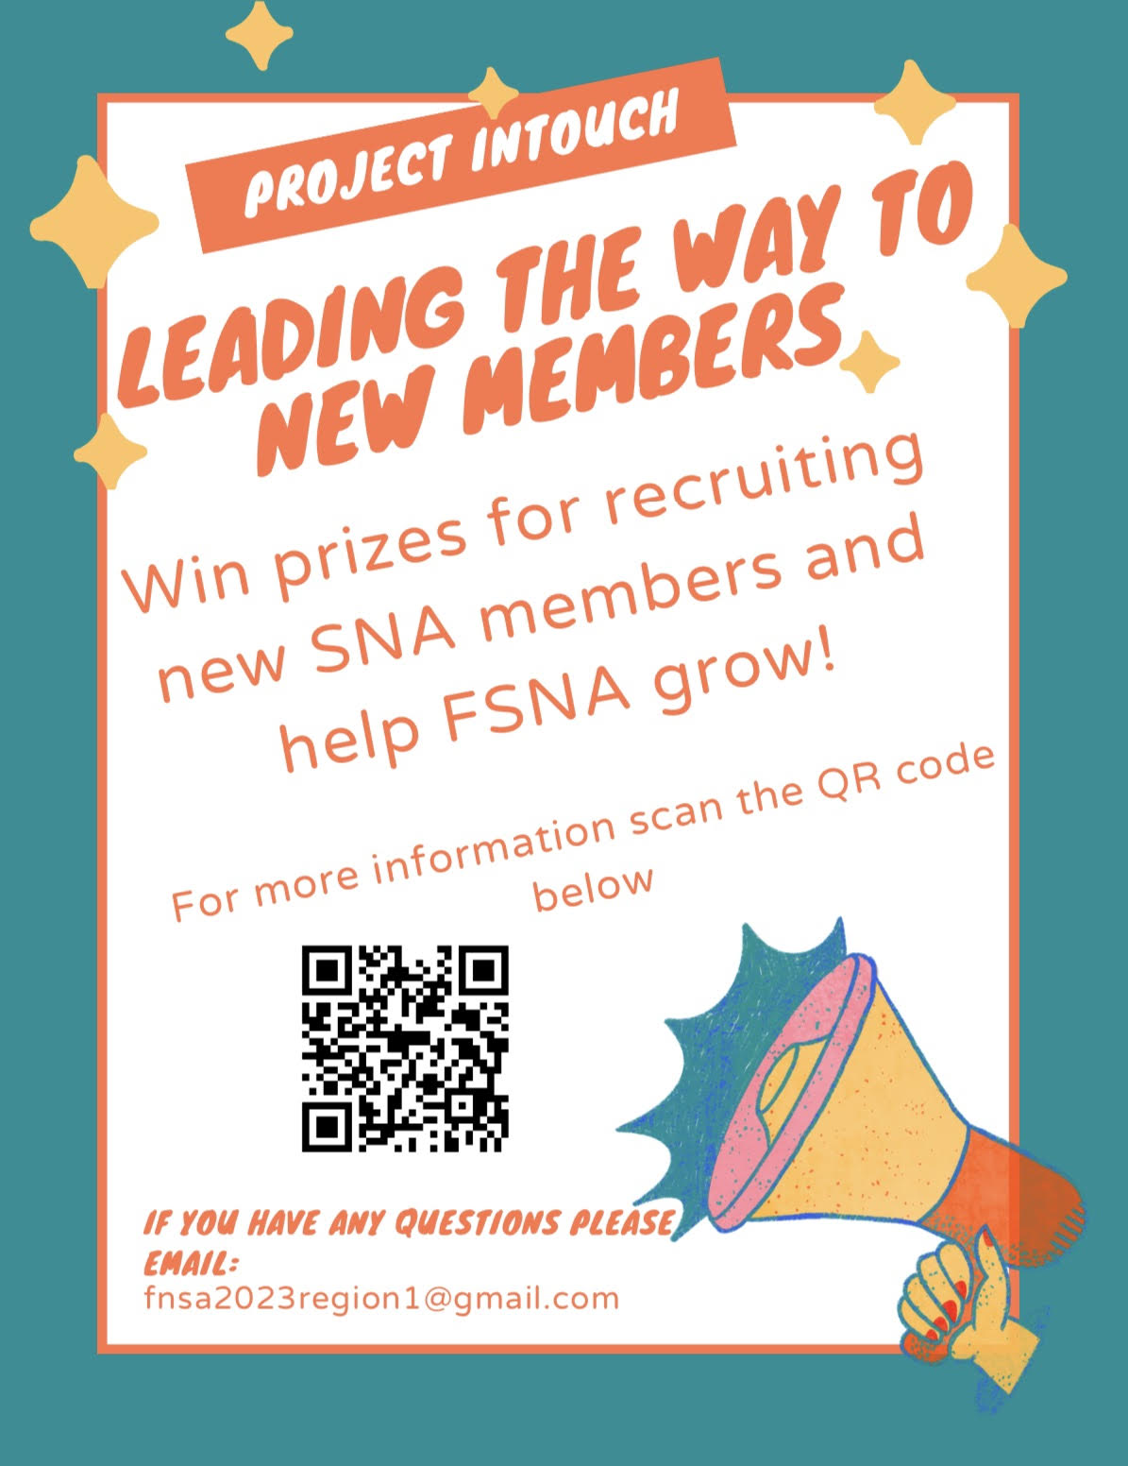
Membership Recruitment Strategies
Notes:
Organize accomplishments and activities of your local chapter and make it available to your prospective members. A scrapbook or photo album is an excellent way to do this. Include involvement of your local chapter at state and national activities as well.
Invite new students to your meetings and allow them to network with current members.
Hold an informal open house or picnic. Create a mentor program so that current members can sponsor a new member.
Invite a state or national officer to speak at your meetings.
Involve your members with projects and committees in order to keep their involvement.
Involve faculty in your activities through the year.
Attend state executive board meetings to learn more about the organization on a state level.
Prepare colorful bulletin boards that keep members informed of current activities.
Start a newsletter to distribute to members.
Give door prizes away at the meetings.
Have local restaurants donate food for meetings and activities.
Showcase Accomplishments
- Highlight notable achievements and projects completed by the local chapter.
- Emphasize the chapter's involvement in state and national activities.
Engagement Opportunities
- Discuss opportunities for prospective members to get involved.
- Mention the value of networking with current members.
Open House or Picnic
- Promote the upcoming informal open house or picnic.
- Explain the benefits of attending and how it fosters camaraderie.
Mentor Program
- Present the mentorship program where current members sponsor new ones.
- Highlight how this program eases integration and provides support.
Guest Speakers
- Announce plans to invite state or national officers as guest speakers.
- Stress the educational and networking benefits.
Member Engagement
- Discuss various projects and committees members can participate in.
- Emphasize the importance of member involvement.
Faculty Involvement
- Explain how faculty members are an integral part of your activities.
- Mention ways in which faculty contribute to the chapter's success.
State-Level Engagement
- Encourage attendance at state executive board meetings for deeper insights.
- Highlight the importance of understanding the organization on a state level.
Communication Tools
- Share the colorful bulletin boards that keep members informed.
- Promote the newly launched newsletter as a source of chapter updates.
Incentives
- Mention the practice of giving away door prizes at meetings.
- Highlight how local restaurants contribute by donating food for events.
Closing
- Summarize the key takeaways and benefits of joining the local chapter.
- Encourage prospective members to attend the next meeting or event.
Project InTouch
Another great way to build the membership at your school is by introducing the NSNA Membership Incentive Program.
When you join NSNA by calling or applying online, you'll be assigned a unique recruiter number and you'll recieve an information packet along with membership forms.
In addition to growing your schools membership your school will have the opportunity to win valuable prizes by recruiting new members to NSNA. These exciting prizes includes subscriptions, nursing books, Littman stethoscopes, and the grand prize - an all-expenses-paid trip to the national convention.

Slide 47
Breakthrough to Nursing
How to prevent THIS Retain THIS
Create more of THIS

Slide 48
Breakthrough to Nursing Committee
Organize, represent, and mentor students preparing for initial licensure as registered nurses enrolled in baccalaureate completion programs, in becoming practitioners sensitive to the cultural diversity that exists in our society
Advocate for high quality care, utilizing the principles of transcultural nursing.
Promote the development of the skills needed to be responsible, accountable members of the nursing profession who respect the differences and similarities between people.
Notes:
Serves as a mentor to nursing students entering the field.
This is an advocacy role, the BTTN Committee members focus on growing our field and supporting the future of nursing.

Slide 49
Breakthrough to Nursing Committee
BTN Project Ideas –
Visit your local Elementary schools, High schools, Skill Centers, Technical schools, Vocational Centers, Community colleges, and Universities
Participate in a local orientation day or health fair.
Notes:
The BTTN committee is also responsible for creating ideas for nursing outreach! How can we grow the profession of nursing?
Visiting elementary schools, high schools, or more.
Participate in local health days, or job orientations.
This is health promotion and nursing advocacy at its finest!

Slide 50
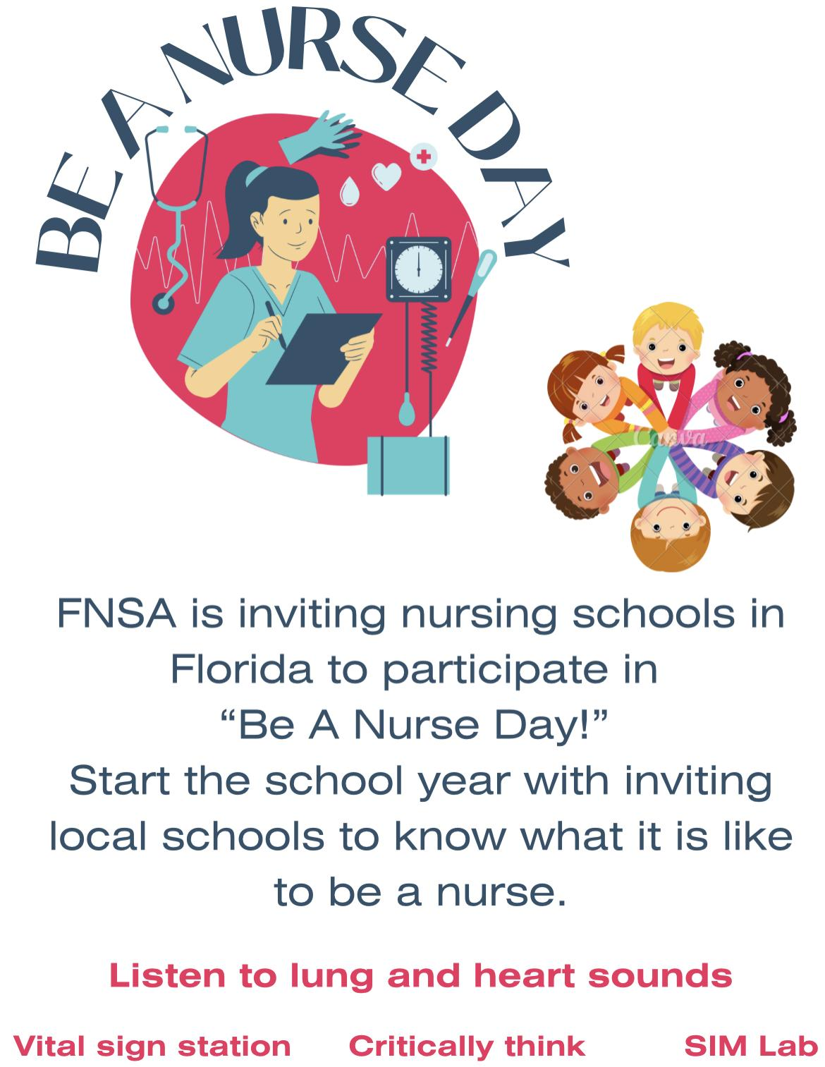
Breakthrough to
Nursing project

Slide 51
Community Health Projects
Ways to break into the community!
Homeless project
pop-up clinics: htn, primary intervention
incidentals, toiletries, etc.
Ex: SALT outreach

Slide 53
Lunch Break
11:30 12:00 pm

Slide 54
Awards

Slide 55
2023 Convention Awards
Dean/ Director of the year
Faculty Excellence Award
Star RN of the year
Membership Award
Legislative Award
Community Health
Communications
Newsletter
Social Media Award
Breakthrough to Nursing
Recruitment
Pennies PRN
Diamond Chapter
Notes:
Here are list of all the awards that I will go into further depth on qualifications. They range from dean, faculty, chapter, and then down to the student level awards

Slide 56
Dean/Director
of the Year
Faculty Excellence Award
Given to the Dean/Director that commits to spreading the mission of FNSA, as well as helping support the students of their chapter.
This person is nominated by the Chapter by submitting a DETAILED letter that explains the type of help and support given.
DEADLINE: all nominations must be submitted by October 6th, 2023.
Given to a faculty member who encourages and inspires students during their nursing school journey.
This person is nominated by submitting a DETAILED letter that explains why this faculty member deserves this award
DEADLINE: all nominations must be submitted by October 6th, 2023.
Notes:
The Dean/director award is given to someone who is committed to spreading the mission of FNSA inaddition to their own chapter. The Faculty of Excellence award is given to an encouraging faculty member that inspires nursing students journey.The Dean and Faculty of Excellence must be nominated through submission of a detailed letter by September 28th. Just to clarify, the faculty member does not have to have a RN licence to receive this award.

Slide 57
Star RN Award
The Star RN of the Year award will be presented to a clinical nurse who demonstrates professionalism and is an inspiration to the next generation of nurses. The nurse can be a preceptor, mentor, or a welcoming nurse on a unit during clinical.
All nominees will receive a certificate of nomination and a letter of congratulations. In addition, the nominees’ immediate supervisor will also be sent a letter describing the honor.
To nominate a clinical nurse, please complete the following online nomination form:
DEADLINE: All nominations must be submitted by October 6th, 2023.
Notes:
The Star RN award is a new state convention award offered this year. To clarify, this nominee can be a clinical precentor, meteor, or a welcoming RN on the unit. This recipient is someone who demonstrated professionalism and inspiration to the next generation of nurses. Deadline is as follows on the slide.

Slide 58
Membership Awards
Greatest Number of Members
The chapter with the highest number of members.
Greatest Number Increase
The chapter that has the greatest increase in membership from the following year.
Greatest Percent Increase
The chapter who has the greatest increase in membership percentage.
The count will be based on membership at the time of the delegate determination.
Notes:
These awards are dedicated to the Chapters and are dependent on memberships. These counts will be based on membership at the time of delegate determination. The membership awards are as followed. *READ OFF SLIDE*

Slide 59
Legislative Award
Given to the chapter who provides its member with resources needed to be knowledgeable of the legislative processes, informed on nursing issues, and take an active role in helping shape the future of healthcare.
Community Health Award
Given to the chapter who demonstrates leadership and advocates for improving health outcomes within their community.
This can be through blood pressure screenings, blood glucose, Health fairs.
Notes:
The other chapter awards include Legislative and Community Health award. *READ SLIDE*

Slide 60
Communication Awards
Newsletter Award
Application must include copies and/or examples of chapter newsletter to be eligible for judging.
Newsletter award will be based on the following criteria:
Appearance and Form
Regularity of publications
Originality and usefulness of content
Demonstrates creativity
Notes:
The two categories for our communication award is newsletter and social media award. The newsletter award must include copies of newsletters in their application and the following criteria is used for judging

Slide 61
Communication Awards
Social Media Award
The effectiveness of using social medias sites such as Facebook, Instagram, Twitter, etc. to help grow your local chapter, through members and the community.
FNSA board must be given assess or links to social media pages if a chapter wishes it to be eligible for judging.
Criteria for judging:
Organized appearance of social media page
Demonstration/description of chapter’s frequent updating to the social media source
Originality and usefulness of content
Demonstrates creativity
Notes:
The last category for our communication award is social media. Applicants must include access to all social media pages and use the following criteria for judging.

Slide 62
Breakthrough To Nursing Award
How has your chapter spread the knowledge of Nursing through your local chapter and your community?
Looking for recruitment of Pre- Nursing students.
Most creative/effective Breakthrough to Nursing Project.
Recruitment Award
How do you get members to join?
Given to the chapter who shows a creative and determined way of getting students interested to becoming members.
Notes:
Addition Chapter awards include Breaktrough to nursing which is given to the most creative and effective BTN project that helps facilitate their local community with the spread of the knowledge of nursing.
The recruitment is awarded to the chapter who shows a creative way on recruiting new Students to becoming members

Slide 63
Pennies PRN
Given to the chapter that has collected the most money to go towards the FNSA scholarship.
Encourage your students to not only donate pennies but any extra change or dollars that they have. Make it fun by making it a competition between the difference semesters in your program!
Notes:
This year we will be bringing back our Pennies PRN fundraiser. This is a state competition for all the chapters to collect the most amount of money which will be redistributed out as FNSA scholarships. Make sure prior to State Convention to convert the coins collected into a check. Just to clarify, we will taking any heavy jars worth of pennies

Slide 65
Diamond Chapter
The purpose of this award is to recognizes our top high-achieving chapters who display commitment for FNSA’s mission and goals through their activity in the previous year.
Categories being scored:
Official Constituency Status
Faculty Support of Professional Development
Membership
Community Health Participation
Legislative Advocacy & Political Action
Breakthrough to Nursing
Communications
State and National Participation
Handed in-person the first day of Convention, October 23th by 7:00pm.
Notes:
The last chapter award is the Diamond Chapter which recognizes our top achieving chapters who are committed to the FNSA’s mission throughout their school years. The criteria is as follows. All Chapter Awards are handed in person the first day of convection, October 27th by COB
Florida nursing foundation check make out to

Slide 66
Scholarships
All FNSA members enrolled in nursing courses and all recent graduates are eligible for an FNSA scholarship. The source of all FNSA Scholarships will be the Florida Nurses Association Foundation.
The following scholarships are for outstanding individual contributions to FNSA and NSNA. These awards will be $500.00 each.
(1) Heather Scaglione Leadership Scholarship
(1) Claydell Horne Leadership Scholarship
(1) Willa Fuller Leadership Scholarship
(1) Mary Tittle Leadership Scholarship
(1) Paula Massey Leadership Scholarship
(1) The Carol Petrozella Educational Leadership Award- is for any individual interested in going into Nursing Education.
https://form.jotform.com/232575636609061
Notes:
These are all the following scholarships awarded this school year. The qualifications include being a recent nursing graduate or nursing student that is an active FNSA member. Each scholarship accumulates is 500 dollars

Slide 67
Getting involved in legislative action

Slide 68
Legislative
DATES TO REMEMBER
Last Day to Register to Vote in the General Election - October 11, 2022
Florida General Election - October 7, 2024
Advocacy Days -
February 8-9, 2024
Notes:
Three of the most important things that we can do for our selves, our patients, and our communities are to Vote and Advocate on their behalf.
Advocacy ensures that needs of the communities are being heard by those in positions of power.
Voting ensures that the people elect leaders that will ensure their needs will be met and interests will be protected.
We Care, We Vote
‹#›

Slide 69
Committees

Slide 70
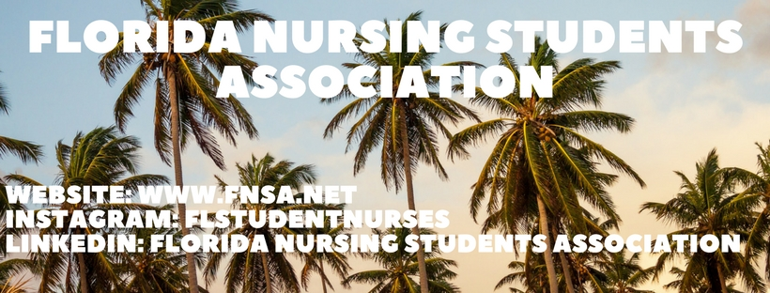
Communications Committee
Responsible for…
Posting each edition of the ​Hotline and region newsletters to the website
Updating the calendar and announcement pages
Keeping all the members up to date with our events
Notes:
This is equivalent to the social media department!
Websites, social media accounts, calendars, and events. They are the committee that handles it all.

Slide 71
Sign up to be on a state committee
https://form.jotform.com/232575342546055

Slide 72
Community Health Chair
Initiate and maintain contact with local chapters on community health projects or ideas.
Distribute information on national and state Community Health projects to the chapters.
Write articles related to Community Health for Hotline.
Submit Community Health state projects for NSNA National Convention.
Work in conjunction with Prevent Blindness of Florida, when possible.
Notes:
The community health committee is our public and community health sector which focuses on pushing the boundaries of nursing outside of the hospital and into the community
we do this via outreach and state wide projects that support communities in need.

Slide 73
Image of Nursing
Nurses are Most Trusted Profession for 20th Straight Year (Gallup, 2022).
This committee was created to keep the Image of a nurse professional and positive.
This committee highlights the different types of people who make up the nursing student and profession nursing community via the Hotline.
Notes:
The image of nursing committee highlights the nursing profession as a whole.
this is a representation group and strives to educate and support the integration of all areas of nursing into one unit.

Slide 74
Legislative Committee
Consist of members from each region of the state, when possible.
Initiate contact and work in conjunction with FNA, NSNA, FLN, and FNA Legislative Committees.
Encourage chapters to initiate and maintain contact with their local legislative districts.
Provide each chapter with information on how to utilize the “political process” effectively to be of influence in health care issues.
Encourage and promote voter registration on the chapter and state level.
Notes:
The Legislative Committee is involved in the promotion of legislative action and advocacy regarding the political process.
‹#›

Slide 75
Membership Committee
Responsibilities
Exchange of Ideas and Activities between Membership Chairs
Mail-outs prior to convention
Membership Drive/Recruitment
Nursing Student Week!
Convention Awards
Greatest Percentage Increase in Membership Award
Highest Membership
Greatest Number Increase
Constituency Status Application
NSNA Membership Reports
Notes:
The main focus of this Committee is Recruitment - this happens throughout the year during different events planned such as;
Welcome weeks
Membership drives etc.

Slide 76
Policy Committee
Be chaired by the Recording Secretary and consist of members who represent each region of the state, when possible.
Interprets the bylaws and policies’ function with appropriate actions
Review policies annually and submit the revisions to the Executive Board for approval or deemed necessary by the board
Distribute the revised policies to the chapters no later than the annual meeting of the FNSA.
Perform all other duties pertaining to the office.
Notes:
Our policies committee is in charge of policy revision and this group works in tandem with the recording secretary to facilitate changes to FNSA policy and procedure.

Slide 77
Ways and Means Committee
Be chaired by the Treasurer and consist of members who represent each region of the state, when possible.
Formulate, organize, initiate, and implement fund-raising activities with prior approval of the Executive Board.
Be responsible for all FNSA Scholarship funds and monies from Pennies PRN.
Be responsible for sustaining membership drives.
Initiate an exchange of ideas and information regarding fund-raising activities between NSNA, FNSA, and local chapters.
Perform all other duties pertaining to the office.
Notes:
The ways and means committee is lead by the treasurer and is responsible for
fundraising and and financials so if this is your area of interest you should apply!

Slide 78
Liaisons
What are Liaisons?
They are selected to represent the organization at important committee and task force meetings for state organizations and other entities and report back to the FNSA Executive Board.
Available Positions
Florida Nursing Association Board Liaison – Orlando, FL
FNA Bylaws Committee Liaison – Orlando, FL
Florida Board of Nursing Liaison – Tallahassee, FL
Florida Center for Nursing Liaison – Orlando, FL
Florida League for Nursing Liaison
Florida Nurses Political Action Committee Liaison
QUIN Council Liaison
Special Interest Group Liaison
https://form.jotform.com/232574988080063

Slide 79
Open Discussion/Q&A

Slide 80
Lets Stay Connected!
www.fnsa.net
@FLstudentnurses
FL Student Nurses Association on Facebook!

Slide 81
Thank you
See you at convention in October!!
Please reach out if you have any further questions

